Slide 1
2 tam giac dong dang (truong hop 1)

Slide 2
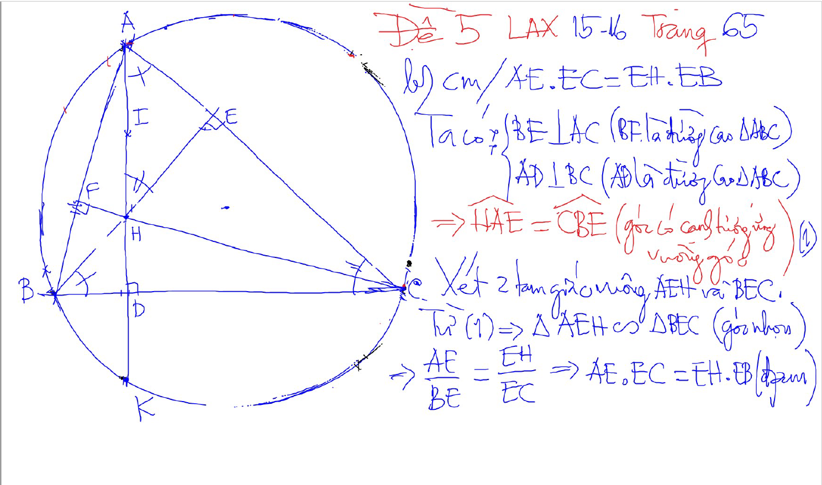
2 tam giac dong dang (truong hop 1)
2 goc bang nhau
1 goc nhon bang nhau

Slide 3
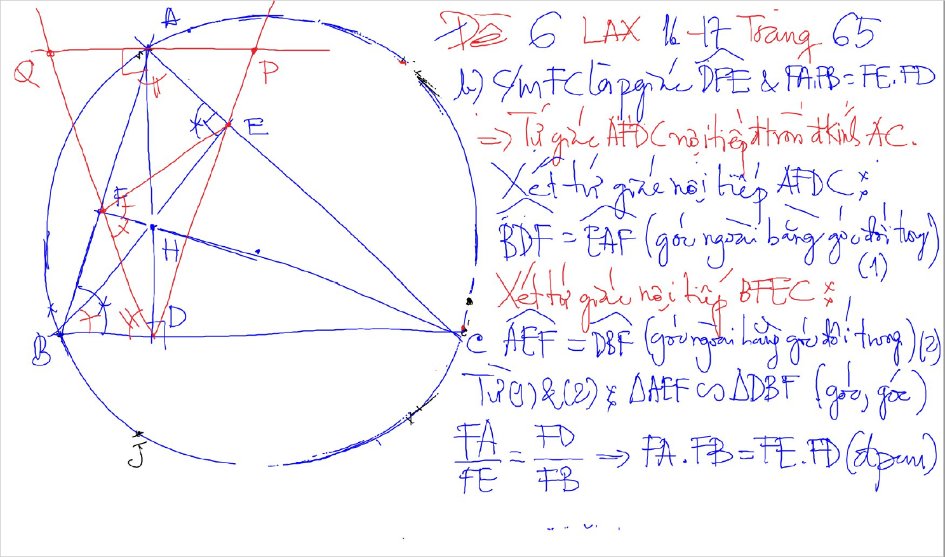
2 tam giac dong dang (truong hop 1)
2 goc bang nhau
1 goc nhon bang nhau

Slide 4
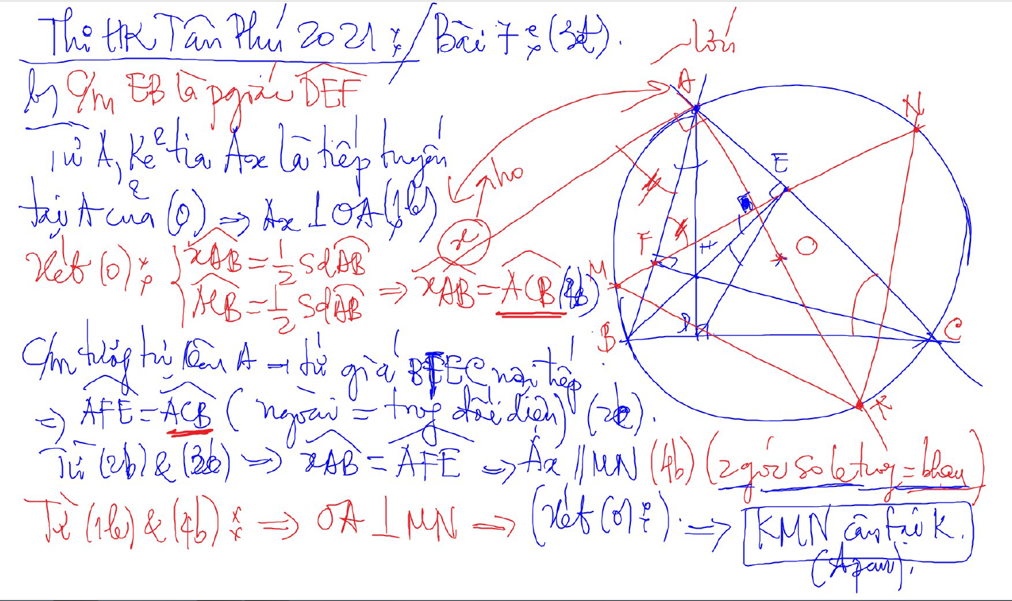
C/m tam giac dong dang truong hop 2

Slide 5
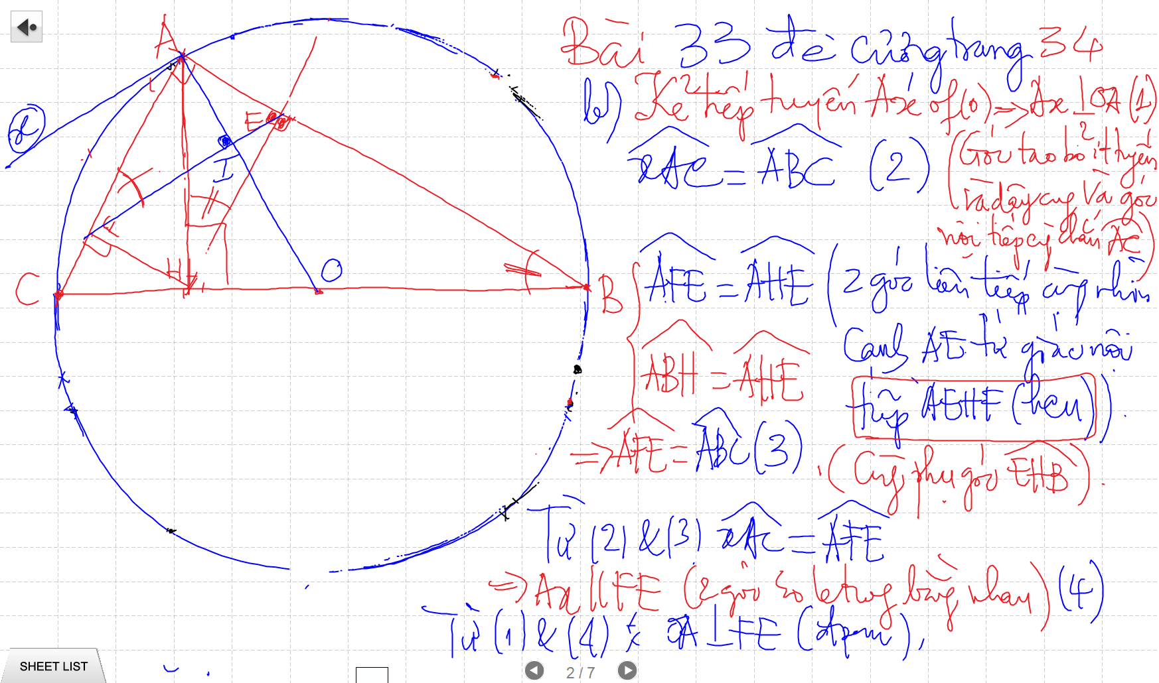
C/m tam giac dong dang truong hop 2

Slide 6
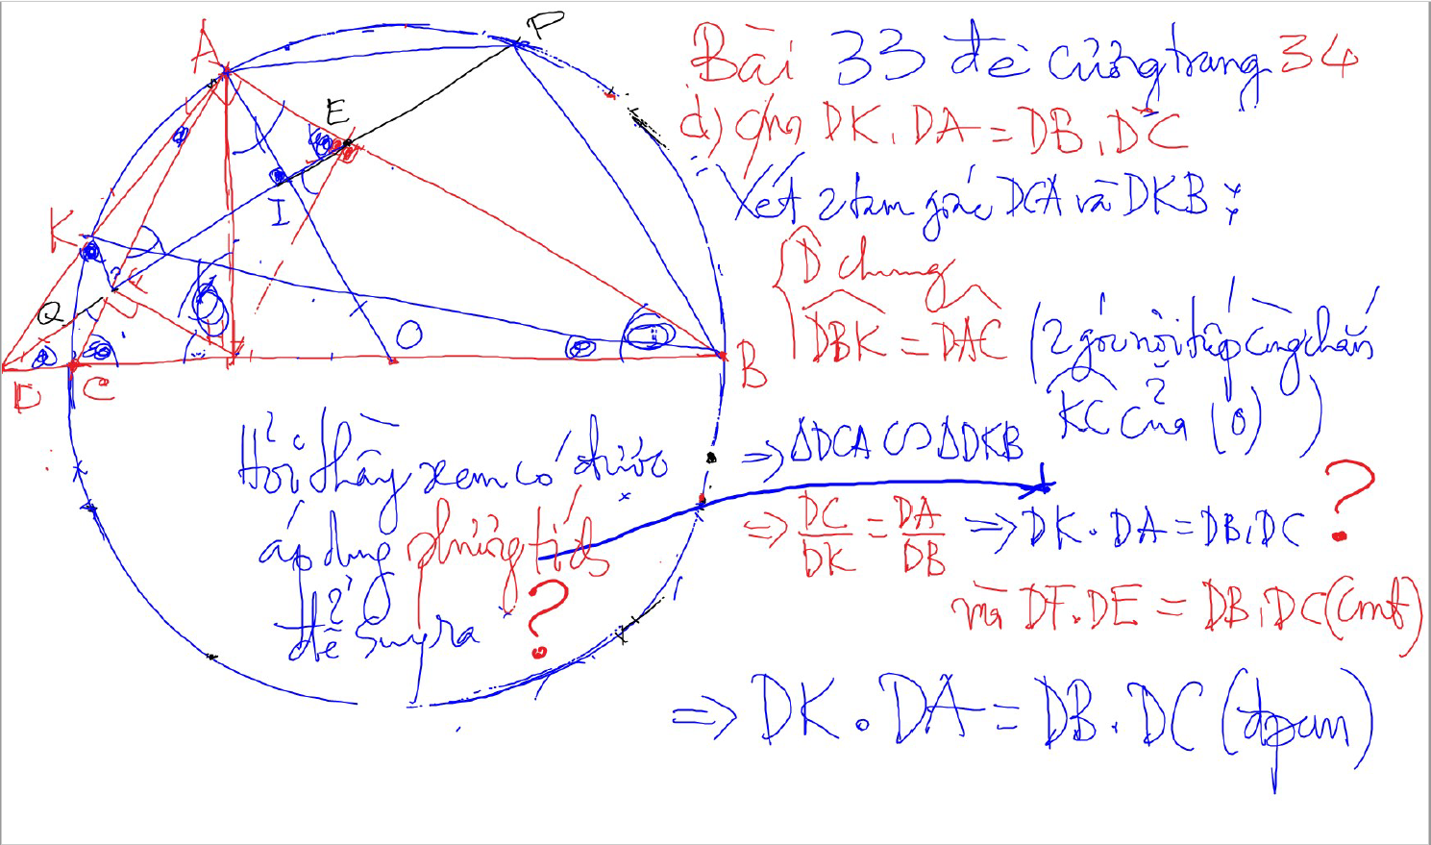
C/m tam giac dong dang truong hop 2

Slide 7
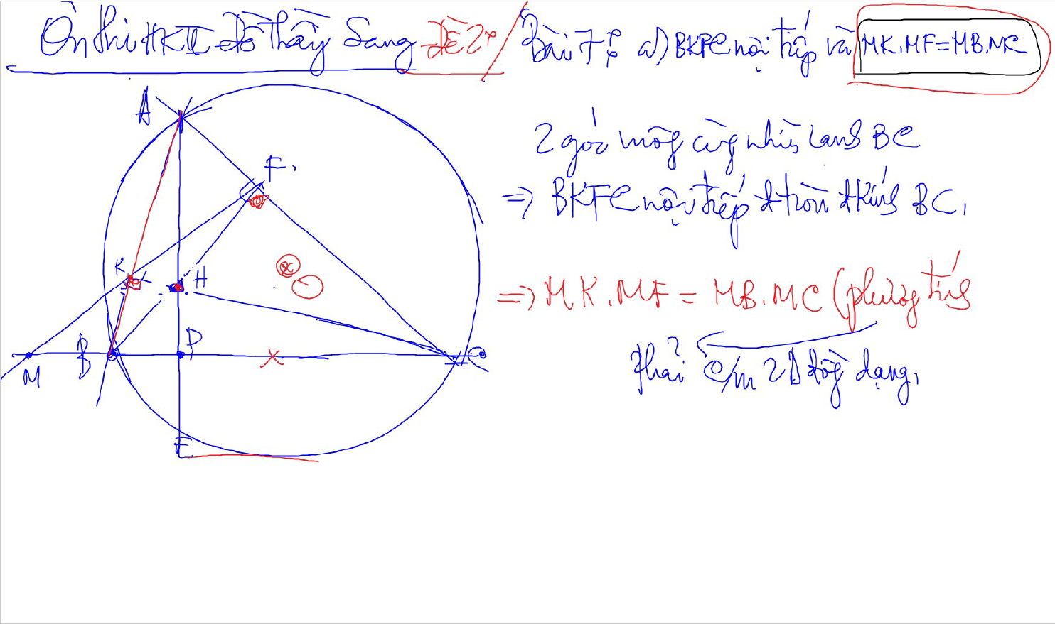
C/m tam giac dong dang truong hop 2

Slide 8
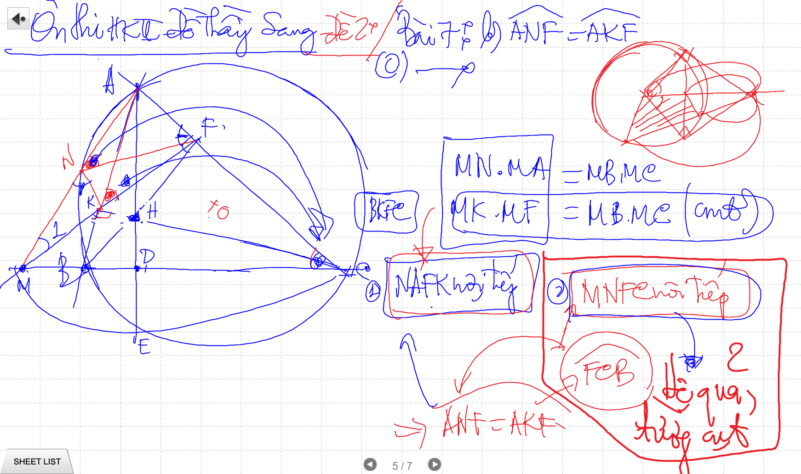
C/m tam giac dong dang truong hop 2

Slide 9
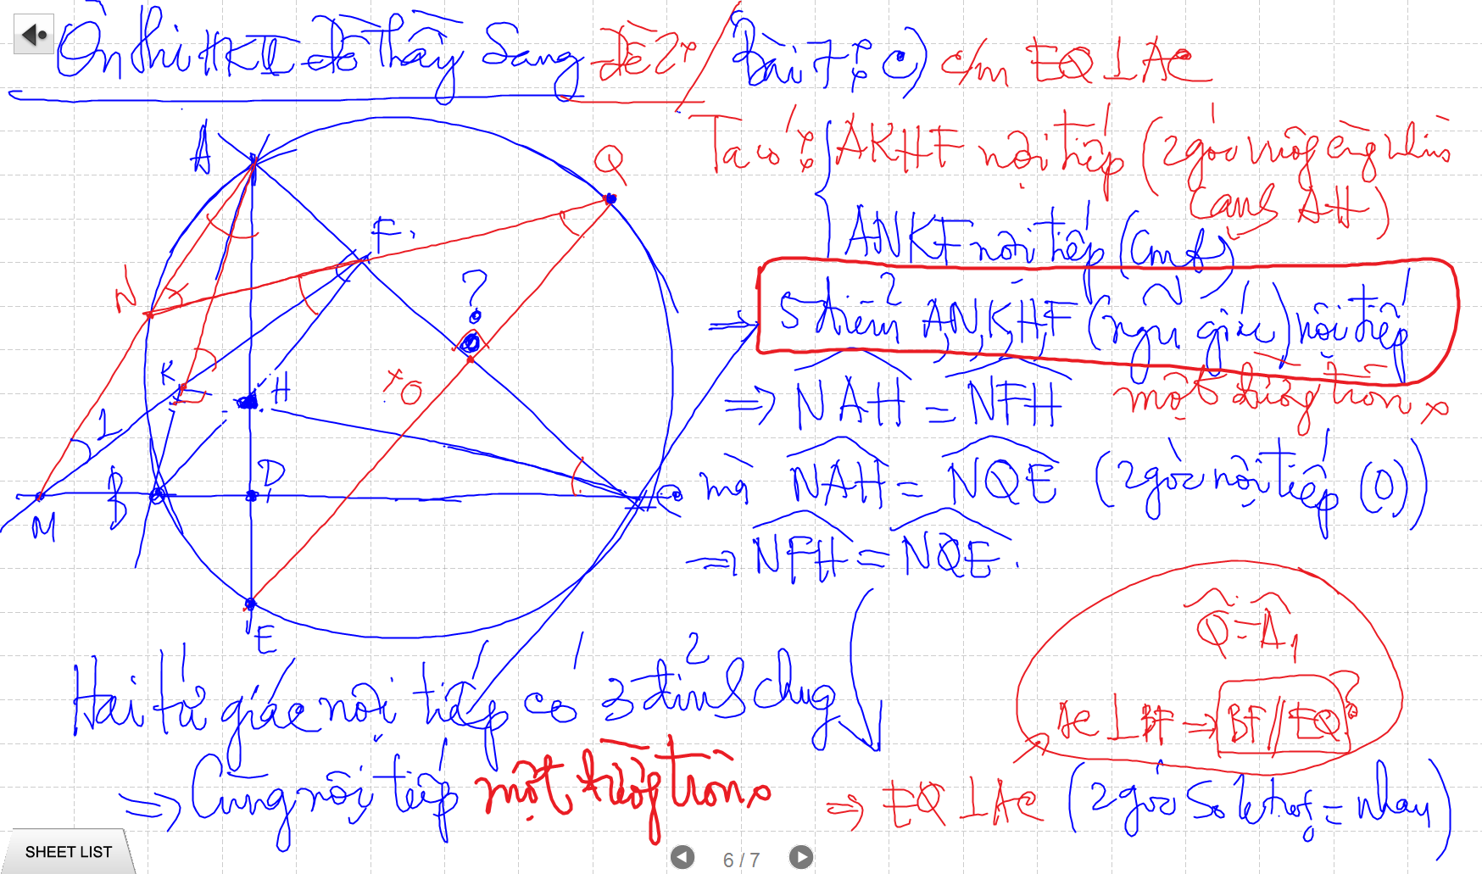

Slide 10
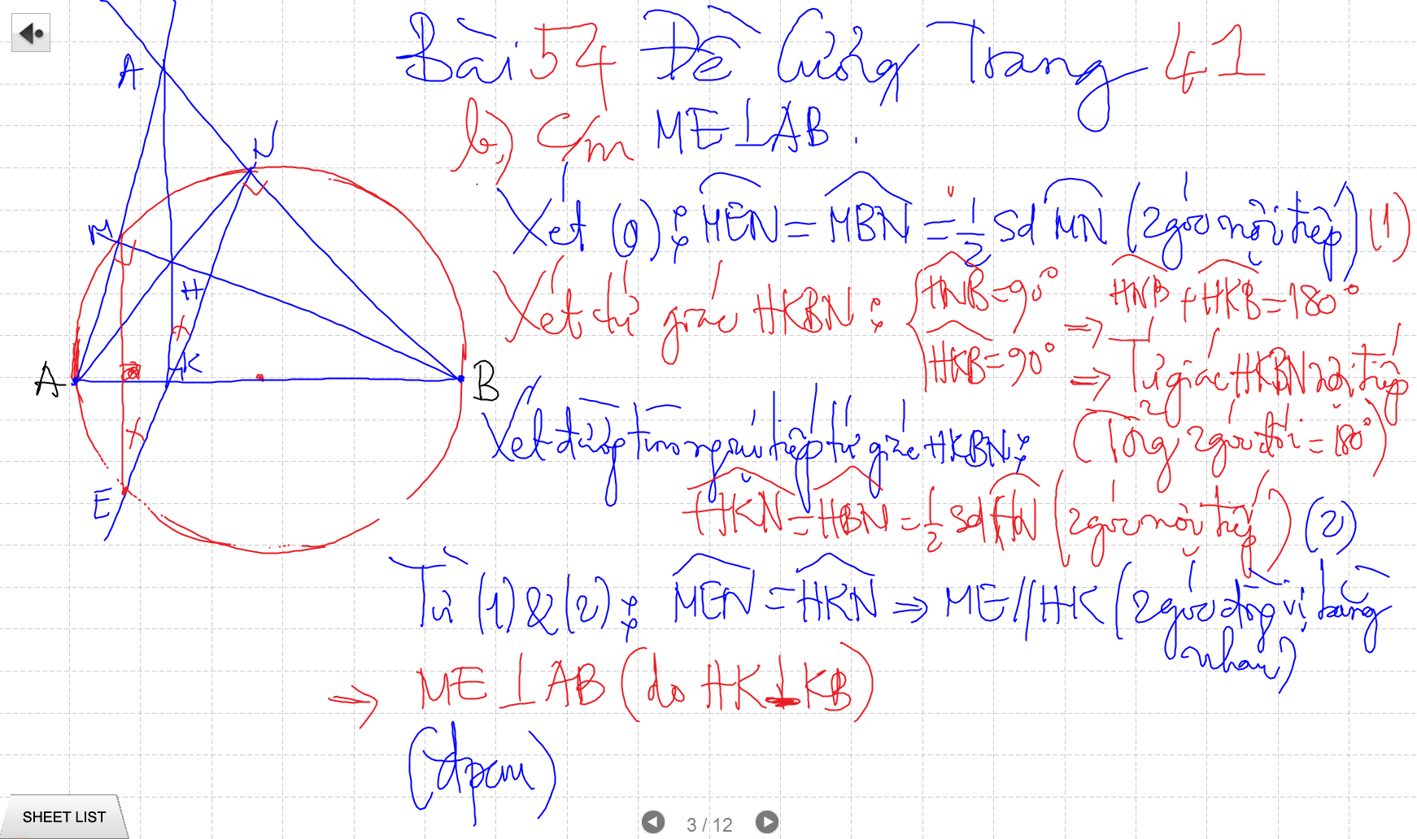

Slide 11
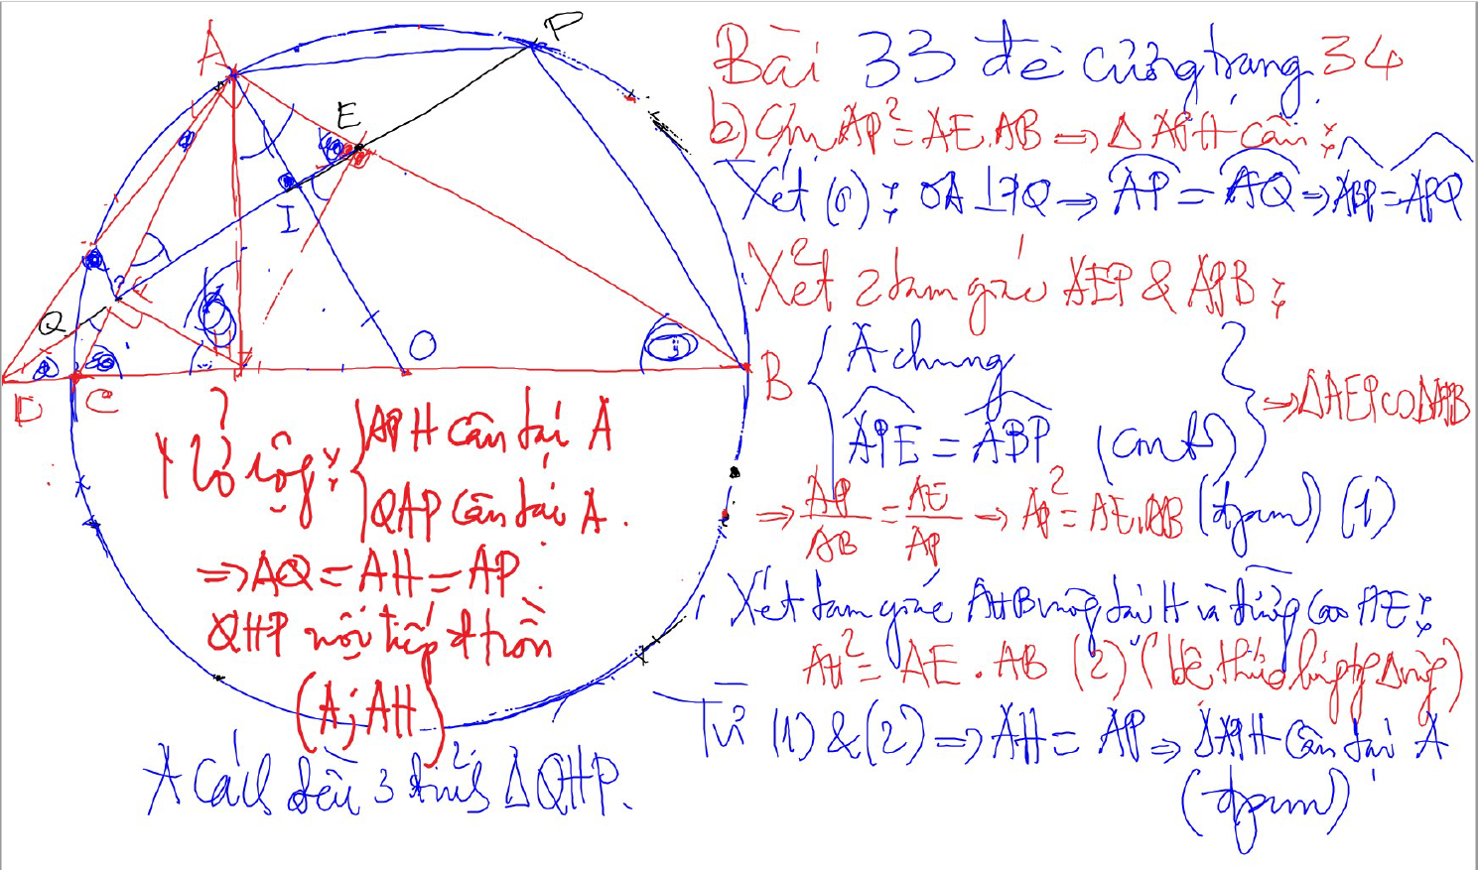
Bai 53 De Cuong – Kinh dien tam giac nhon 1 (xem trong thu muc Tu Giac Noi Tiep)

Slide 12
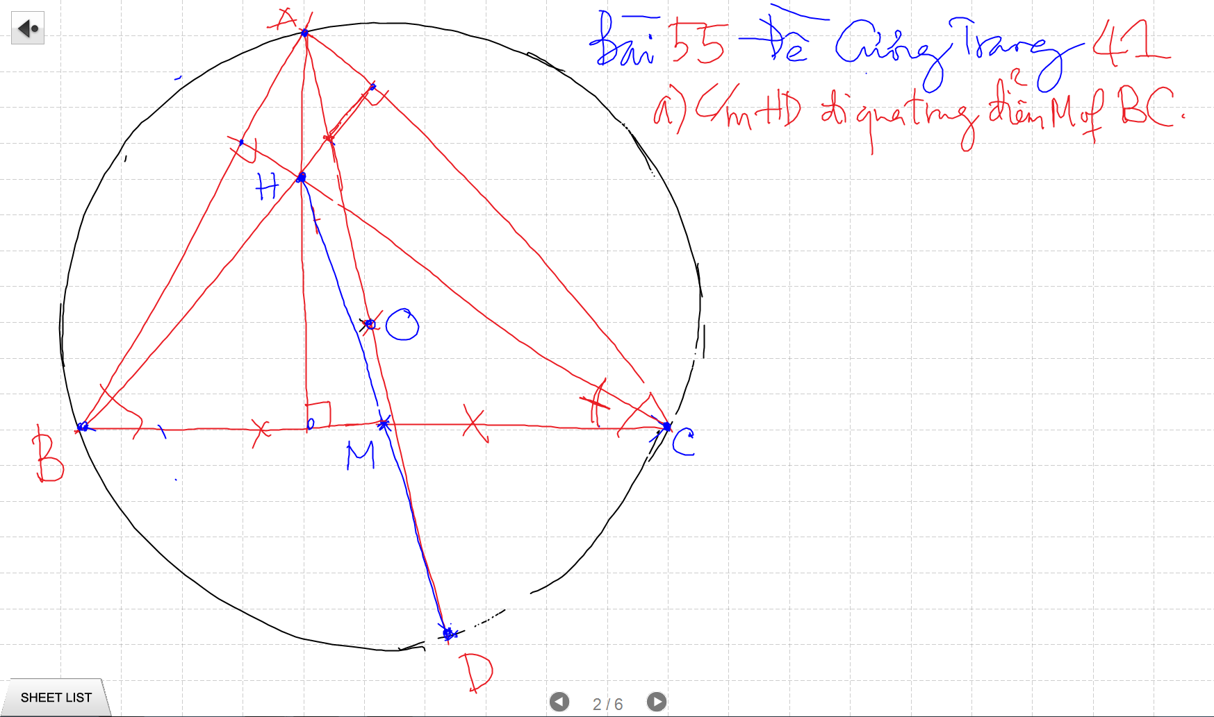

Slide 13
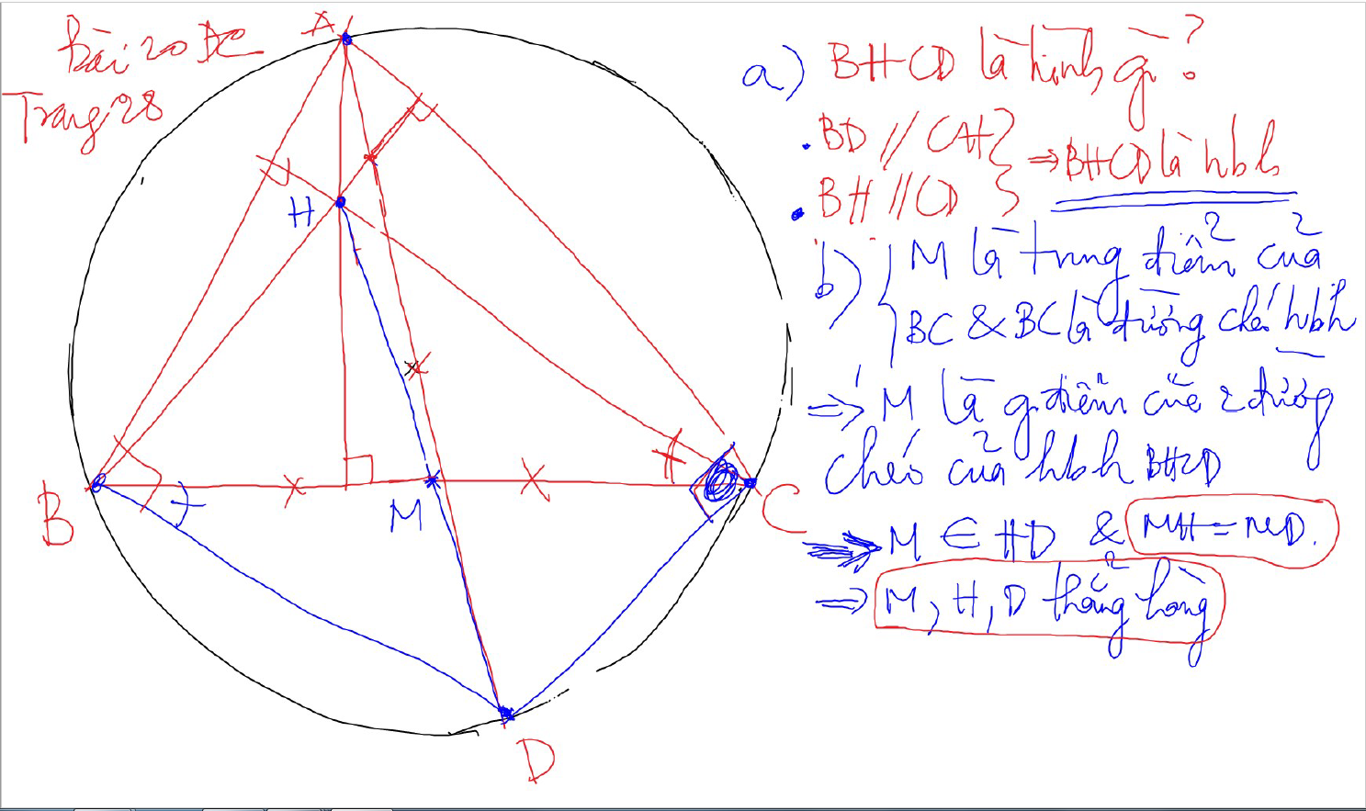

Slide 14
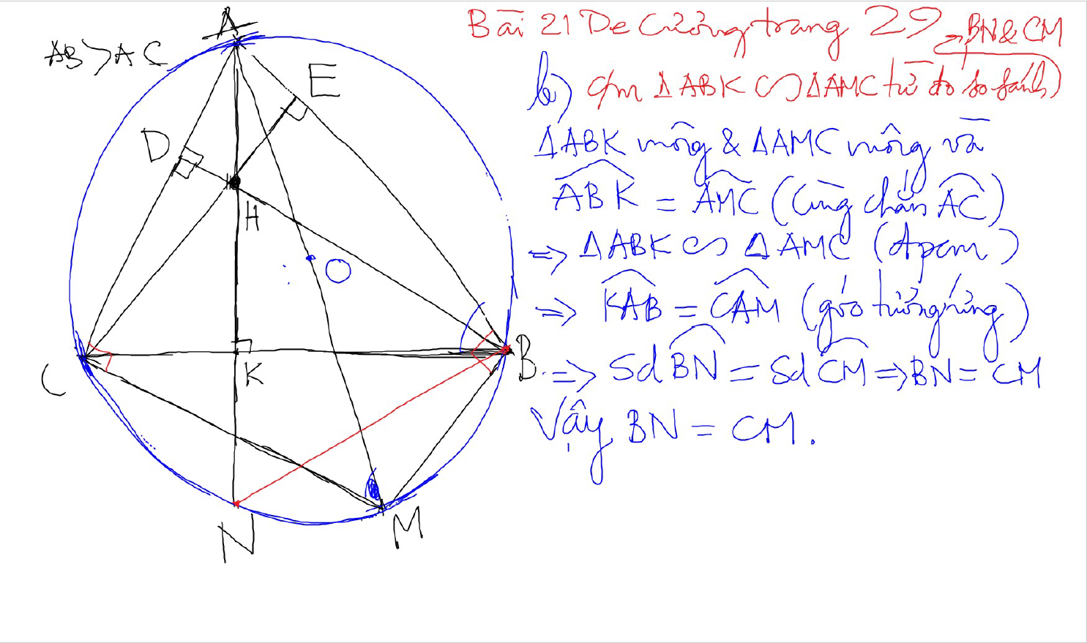

Slide 15
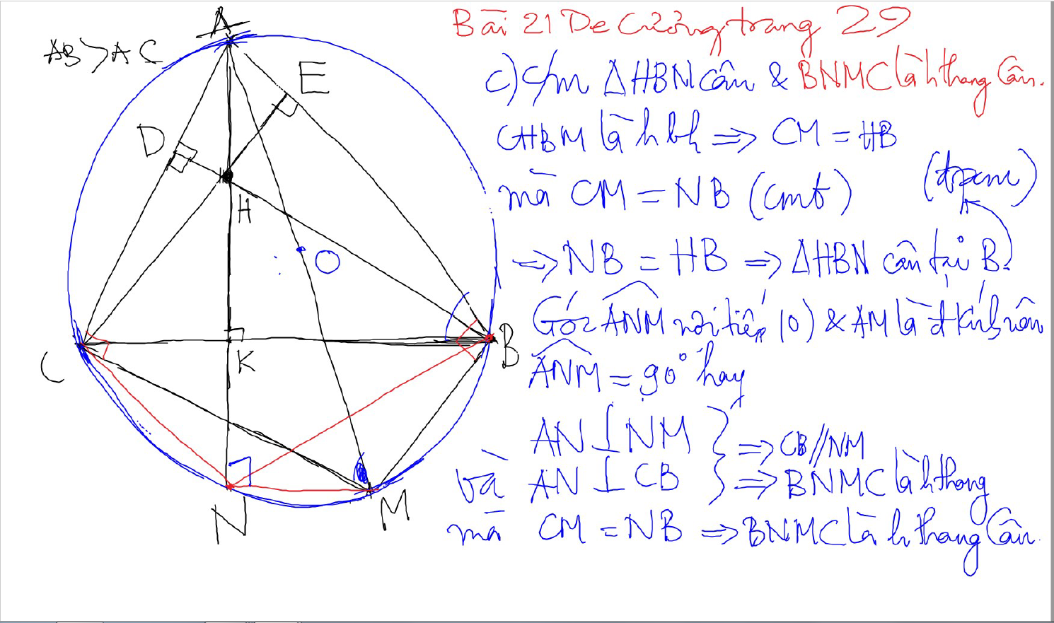

Slide 16
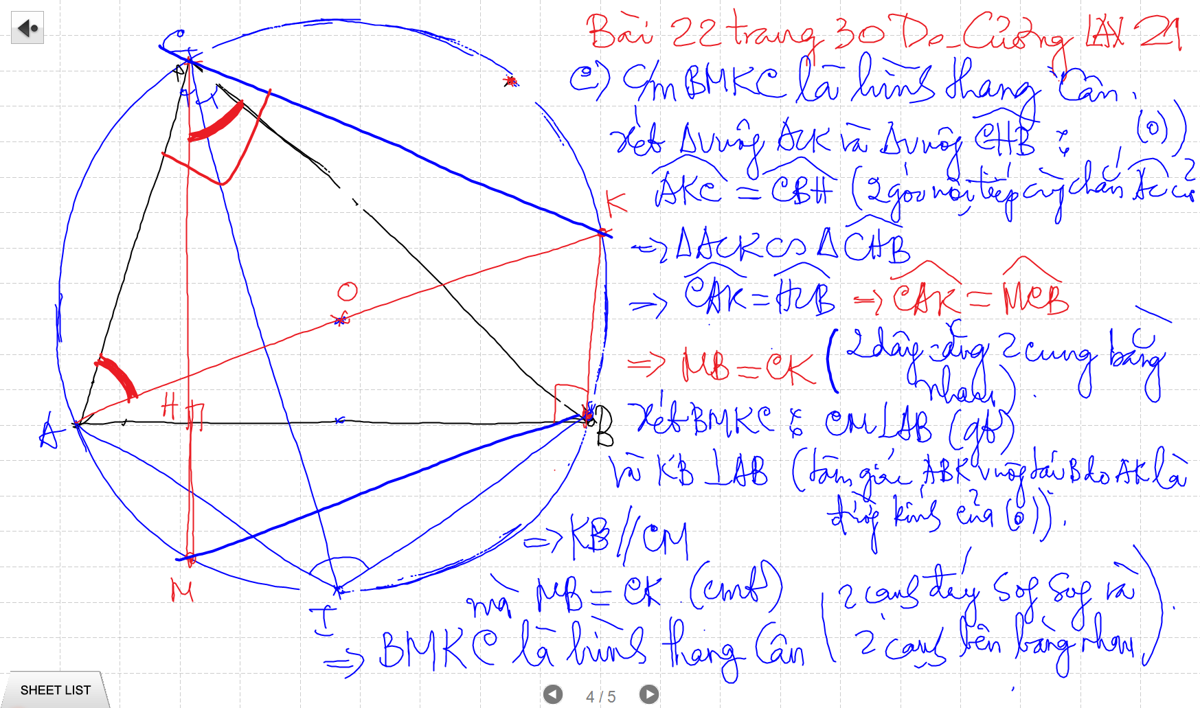

Slide 17
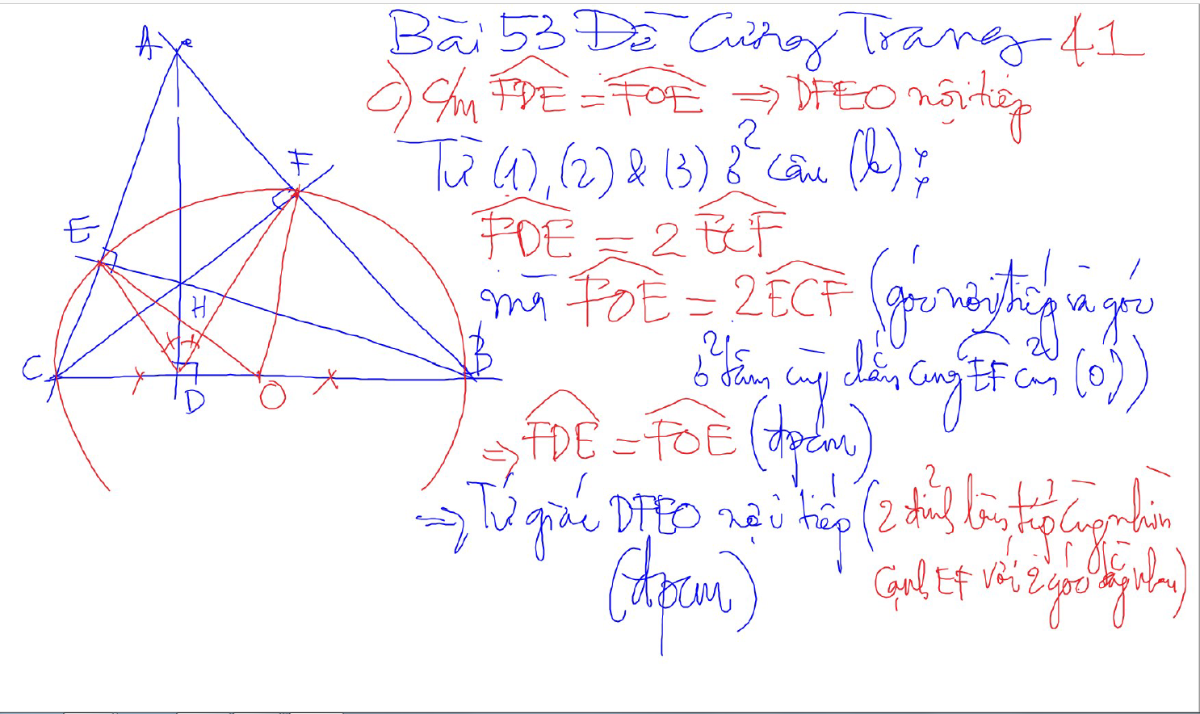
Bai 53 De Cuong – Kinh dien tam giac nhon 1 (xem trong thu muc Tu Giac Noi Tiep)

Slide 18
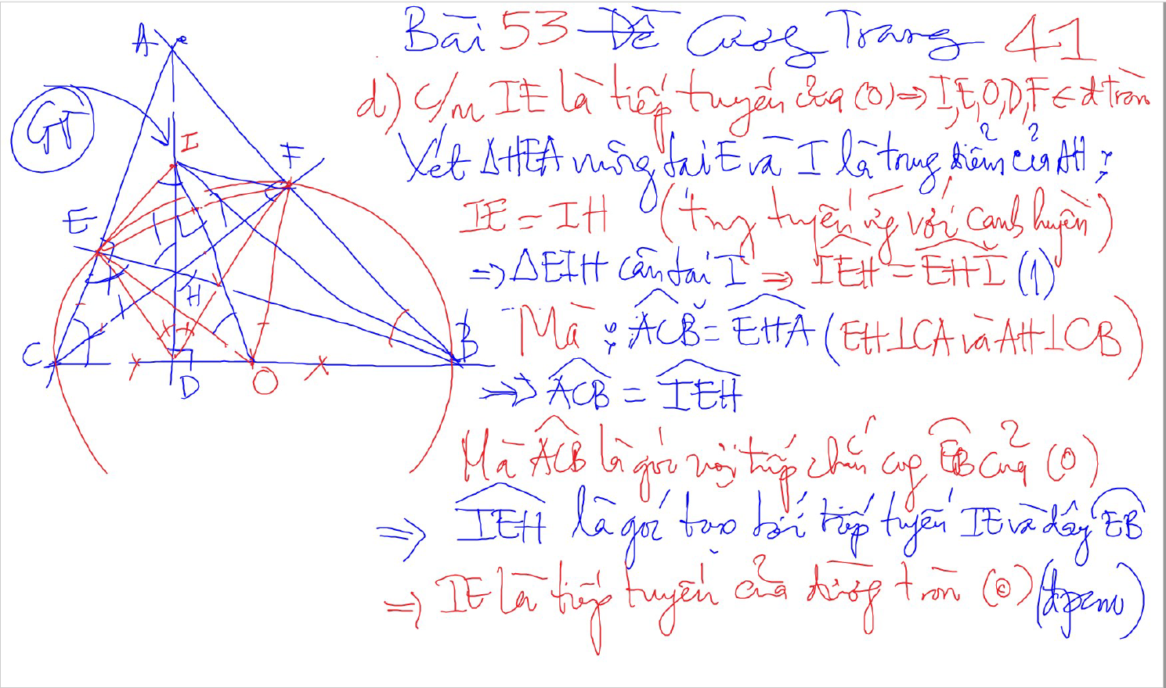
Bai 53 De Cuong – Kinh dien tam giac nhon 1 (xem trong thu muc Tu Giac Noi Tiep)

Slide 19
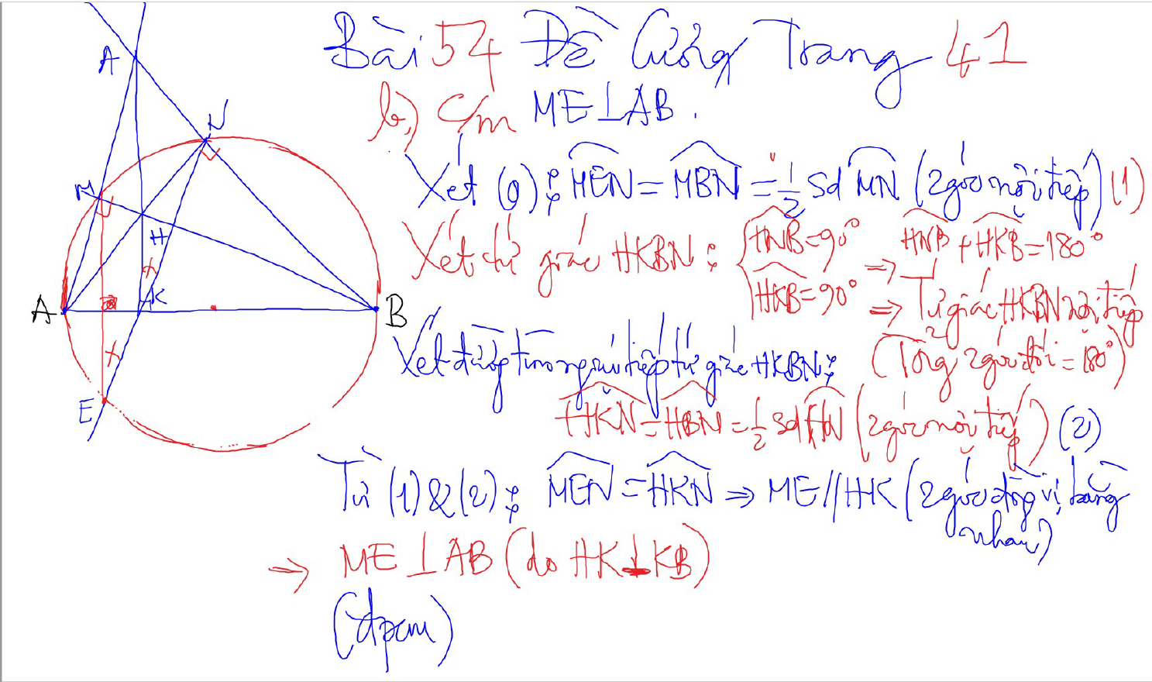
Bai 54 De Cuong – Kinh dien tam giac nhon 1 (xem trong thu muc Tu Giac Noi Tiep)

Slide 20
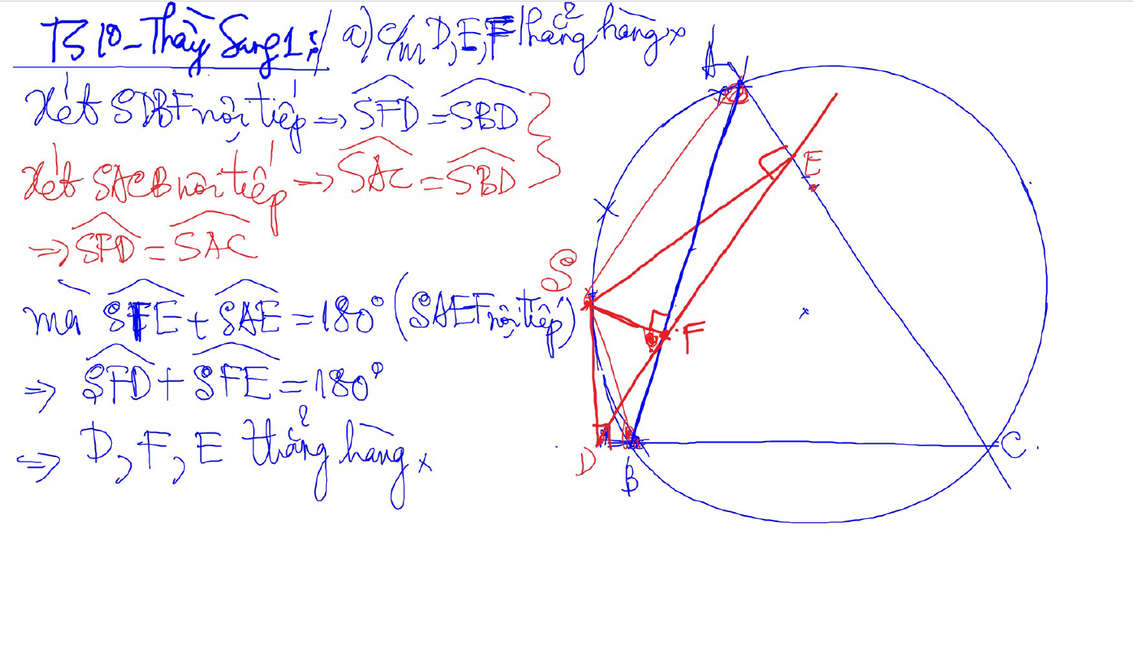
Đường thẳng SIMSON

Slide 21
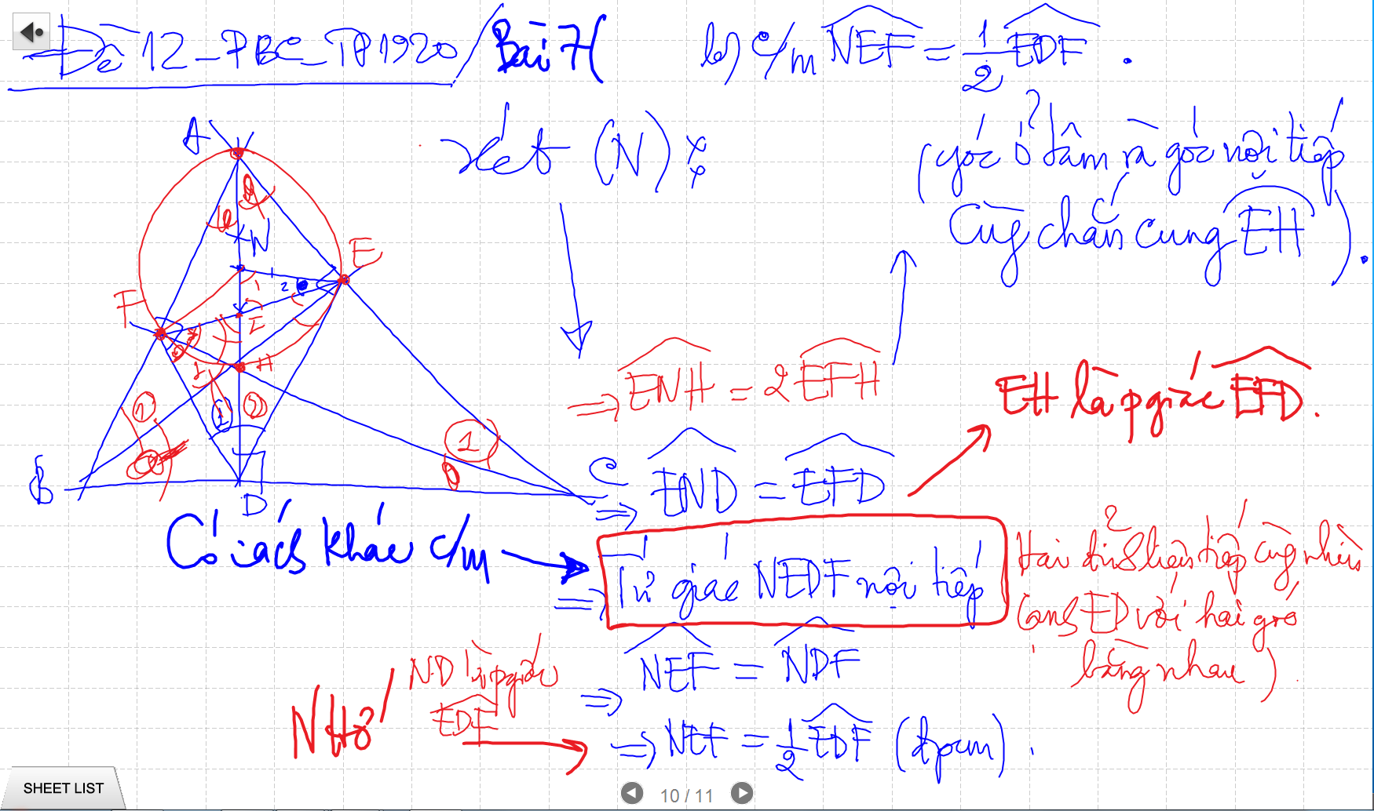
CM TU GIAC NOI TIEP -> SUY RA CAC GOC BANG NHAU

Slide 22
Bai 54 De Cuong – Kinh dien tam giac nhon 1 (xem trong thu muc Tu Giac Noi Tiep)

Slide 23
Bai 54 De Cuong – Kinh dien tam giac nhon 1 (xem trong thu muc Tu Giac Noi Tiep)

Slide 24
Bai 54 De Cuong – Kinh dien tam giac nhon 1 (xem trong thu muc Tu Giac Noi Tiep)

Slide 25
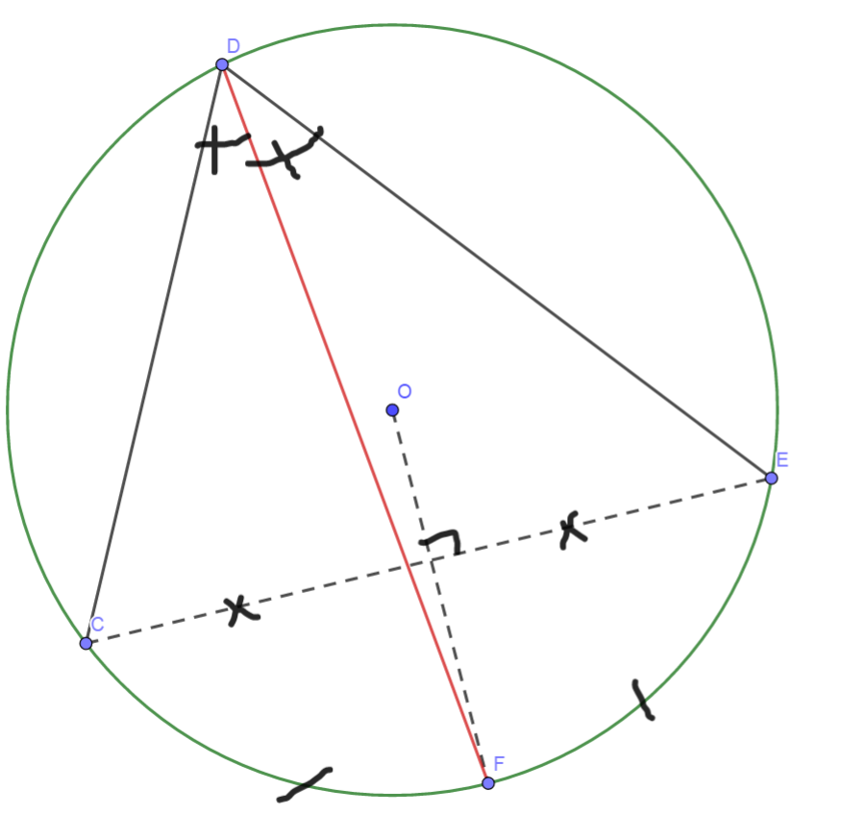
Cach ve duong phan giac cua goc noi tiep

Slide 26
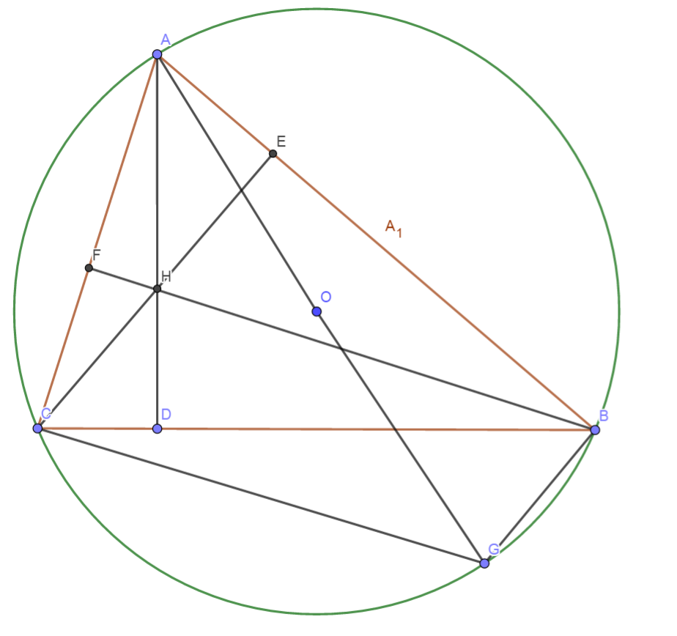
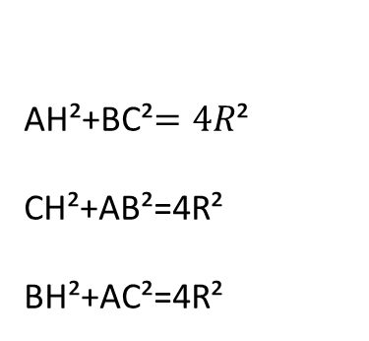
Quan he giua canh day va khoang cach den truc tam
AH²+BC²$=4R$²
CH²+AB²=4R²
BH²+AC²=4R²

Slide 27
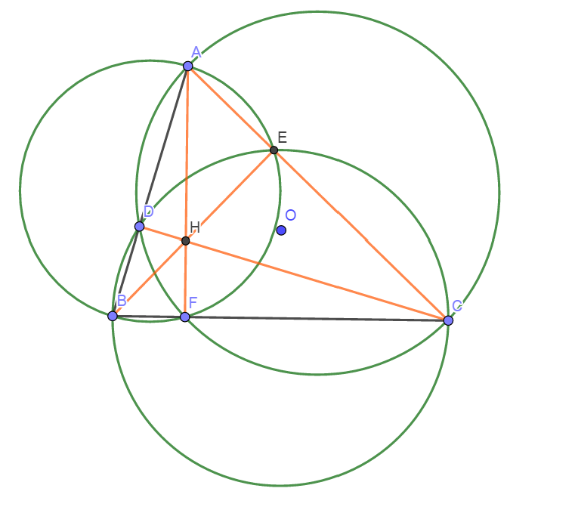
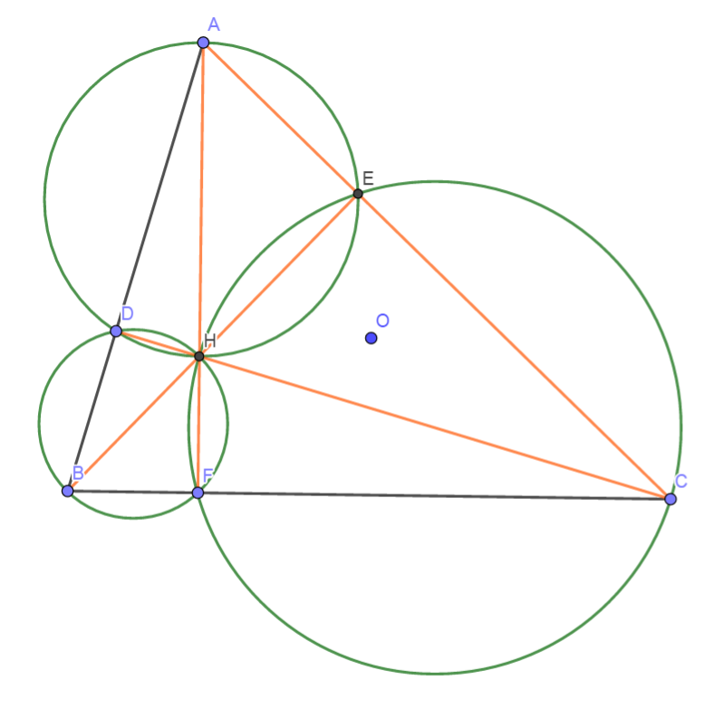
Truc Tam: 6 tu giac noi tiep

Slide 28
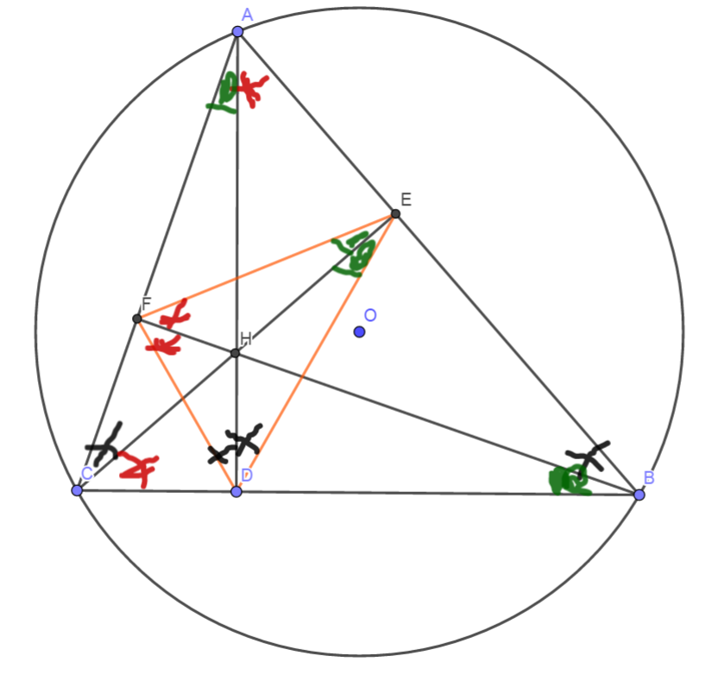
Truc tam: Tinh chat chan 3 duong cao
Chan 3 duong cao tao thanh tam giac DEF
3 duong cao cua tam giac ABC cung la 3 duong phan giac cua tam giac chan duong cao (DEF)
3 tam giac nho o 3 dinh (3 cai banh u) dong dang voi tam giac lon

Slide 29
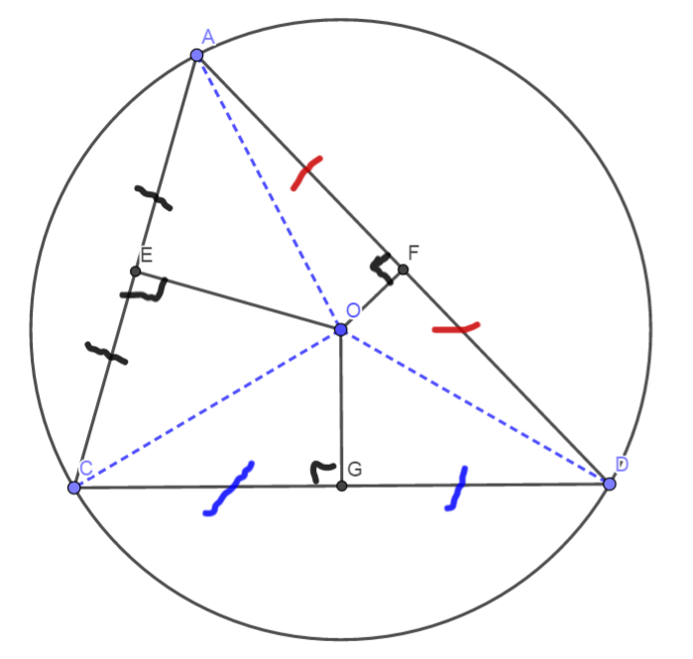
3 duong trung truc dong qui, la tam cua duong tron ngoai tiep tam giac
Giao diem cua 3 duong phan giac la tam duong trong noi tiep tam giac

